Slide 1


MinorProject
Title : Data-Driven Credit Risk Modelling for Financial Decision-Making
Presented by: Sanchit Panwar 500123669
Aayush Kumar 500122815
Saksham Raj 500121902
Guided by: Dr. Surbhi Saraswat

Slide 2
Abstract
  Our project primarily focuses on predicting credit risk percentage and identifying the key factors that contribute to loan rejection. The machine learning models estimate the probability of default (PD) using three baseline algorithms: logistic regression, random forest, and gradient boosting, enabling improved assessment of risk conditions. This approach supports real-time decision-making, allowing borrowers to obtain emergency funds or business loans almost instantly through mobile applications.

Slide 3
Introduction
  Credit risk assessment is essential for financial institutions to maintain stability, profitability, and sound lending decisions. It evaluates the likelihood that borrowers may default, helping banks protect their loan portfolios.
  Traditional approaches such as credit scoring and statistical models often struggle with modern financial complexity and large-scale data. These methods rely heavily on historical trends and simplifying assumptions, which can limit accuracy.
  Modern models analyze borrower profiles, loan characteristics, economic indicators, and market trends to detect hidden risk patterns. Machine learning methods can predict default probabilities more accurately and classify borrowers into risk categories.

Slide 4
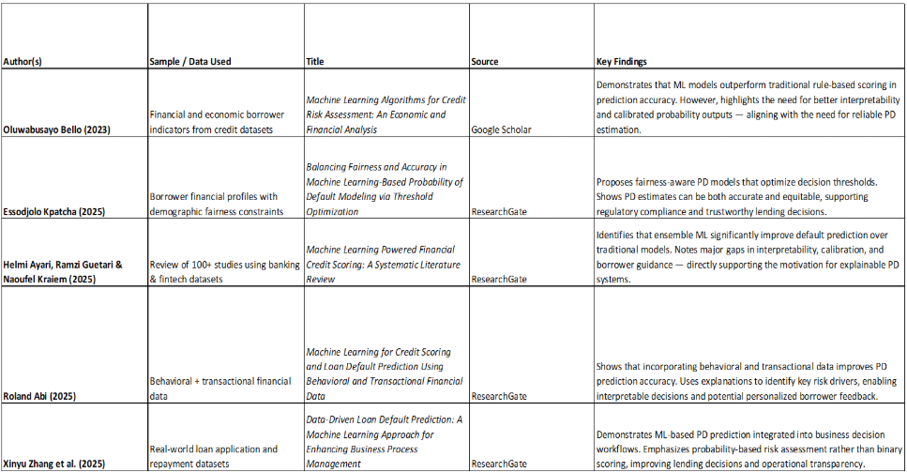
Literature Review

Slide 5
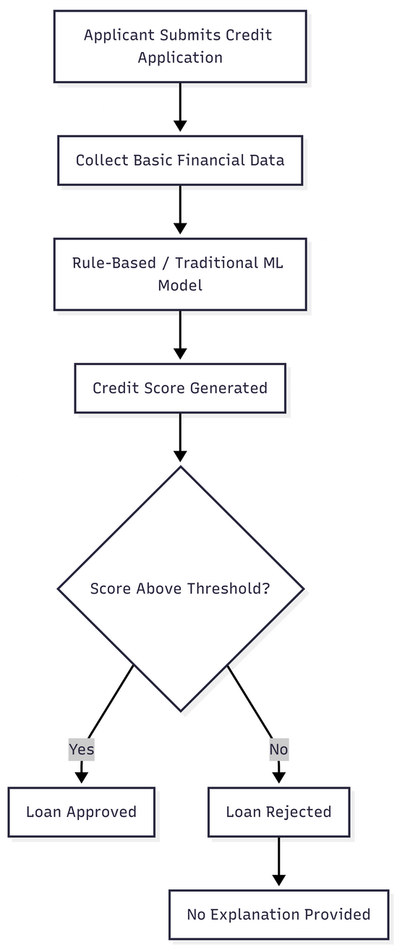
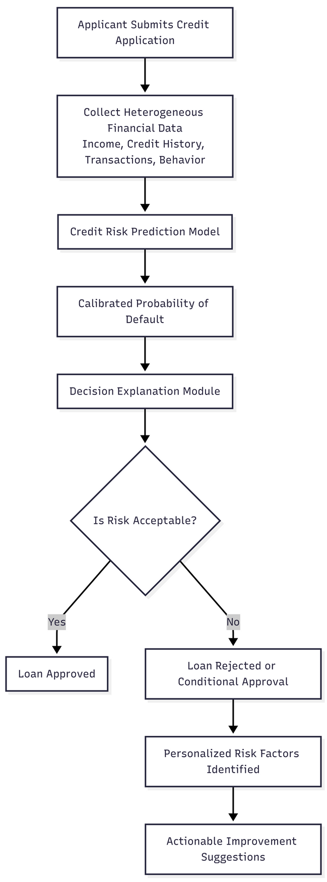
Motivation
  Traditional credit assessment relies on limited data and rule-based models, resulting in rigid scores and low transparency.
  These methods struggle to capture complex borrower behavior and fail to explain decisions, reducing trust and financial inclusion.
  Advanced machine learning models leverage rich digital data to estimate default probabilities more accurately and enable risk-aware lending.
  Incorporating interpretability and personalized feedback supports regulatory compliance and improves customer understanding.
  The project aims to modernize credit risk evaluation through an accurate, explainable, and data-driven system benefiting both lenders and borrowers.
Existing
Proposed

Slide 6
Problem Statement
Existing credit scoring systems either lack prediction accuracy or fail to provide interpretable and well-calibrated probability estimates. Many systems also do not guide rejected or high-risk applicants on how to improve their eligibility.
This project aims to develop a system that combines financial features, Probability of default(PD), deliver reliable credit risk assessment and personalized improvement suggestions.

Slide 7
Objectives
  To build a supervised machine learning system that uses diverse financial data to predict credit default, estimate each borrower’s probability of default, and evaluate performance using both accuracy-based and probability calibration metrics.
  To design a risk scoring system that classifies borrowers into Low, Medium, and High credit risk categories based on predicted probability of default(PD).

Slide 8
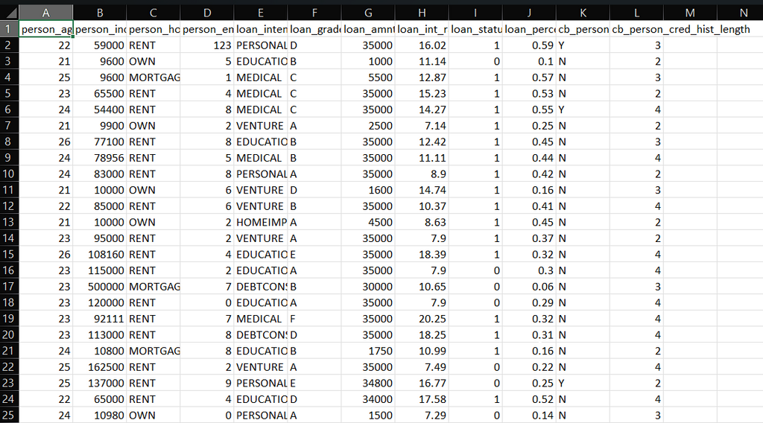
Dataset description
The dataset consists of 32,825 records with 12 attributes, representing borrower demographic, financial, and credit history information. The dataset is used for supervised credit default prediction and probability of default estimation.
It includes features such as age, annual income, home ownership status, employment length, loan purpose, loan grade, loan amount, interest rate, loan status (default or non-default), loan-to-income ratio, historical credit bureau default information, and length of credit history.

Slide 9
Methodology
  Develop a machine learning–based system to estimate the Probability of Default (PD) for loan applicants.
  Use PD estimates to support credit approval decisions and portfolio risk monitoring.
  Ensure regulatory awareness, model transparency, and data privacy.

Slide 10
SWOT Analysis
Strengths
Opportunities
  Improves accuracy over traditional credit scoring
  Supports risk-based decision making with calibrated probability
  Supports banks and fintech with automated, real-time credit risk monitoring while helping consumers understand improvement areas and increase their chances of loan approval
Weaknesses
Threats
  Model performance may degrade over time due to data drift and changing borrower behavior
  Real-time data availability is limited due to privacy and data-sharing restrictions
  Data privacy concerns and bias in historical data
  Regulatory changes and economic shifts may reduce model reliability over time

Slide 11
PERT chart
Activity | Task Description | Estimated Duration
A | Problem Definition & Literature Review | 1 week
B | Dataset Collection & Understanding | 1 week
C | Data Cleaning & Preprocessing | 1–2 weeks
D | Exploratory Data Analysis (EDA) | 1 week
E | Feature Engineering | 1 week
F | Model Training (LR, RF, Gradient Boosting) | 1–2 weeks
G | Model Evaluation & PD Calibration | 1 week
H | Explainability & Threshold Design | 1 week
I | Deployment Prototype | 1 week
J | Monitoring Strategy & Retraining Plan | 0.5–1 week
K | Report Writing & Presentation | 1 week

Slide 12
Area of Application
  Risk-Based Pricing: You can offer personalized interest rates. Instead of a flat rate, you can offer a lower rate to a very low-risk borrower, making your product more competitive.
  Alternative Data: By using utility bill payments, mobile usage, or transaction history, you can provide credit to millions of underserved people who were previously "invisible" to banks.
  Faster Access to Credit: Real-time assessment means borrowers can get emergency funds or business loans almost instantly via mobile apps.

Slide 13
Conclusion
  Develops an explainable credit risk prediction system focused on Probability of Default (PD).
  Helps financial institutions make accurate lending decisions using PD estimates.
  Ensures transparency in the decision-making process.
  Generates default risk scores for each borrower.
  Enables borrower classification into risk categories based on PD thresholds.
  Supports improved credit risk management and portfolio monitoring.

Slide 14
References
[1] Bello, Oluwabusayo. (2023). Citation: Bello O.A. (2023) Machine Learning Algorithms for Credit Risk Assessment: An Economic and Financial Analysis. 109-133. 10.37745/ijmt.2013/vol10n1109133.
[2] Kpatcha, Essodjolo. (2025). Balancing Fairness and Accuracy in Machine Learning-Based Probability of Default Modeling via Threshold Optimization. Journal of Risk and Financial Management. 18. 724. 10.3390/jrfm18120724.
[3] Ayari, Helmi & Guetari, Ramzi & Kraiem, Naoufel. (2025). Machine learning powered financial credit scoring: a systematic literature review. Artificial Intelligence Review. 59. 10.1007/s10462-025-11416-2.
[4] Abi, Roland. (2025). Machine learning for credit scoring and loan default prediction using behavioral and transactional financial data. World Journal of Advanced Research and Reviews. 26. 884-904. 10.30574/wjarr.2025.26.3.2266.
[4] Zhang, Xinyu & Zhang, Tianhui & Hou, Lingmin & Liu, Xianchen & Guo, Zhen & Tian, Yuanhao & Liu, Yang. (2025). Data-Driven Loan Default Prediction: A Machine Learning Approach for Enhancing Business Process Management. Systems. 13. 581. 10.3390/systems13070581.

Slide 15
THANK YOU

